Slide 1


Welcome

Slide 2
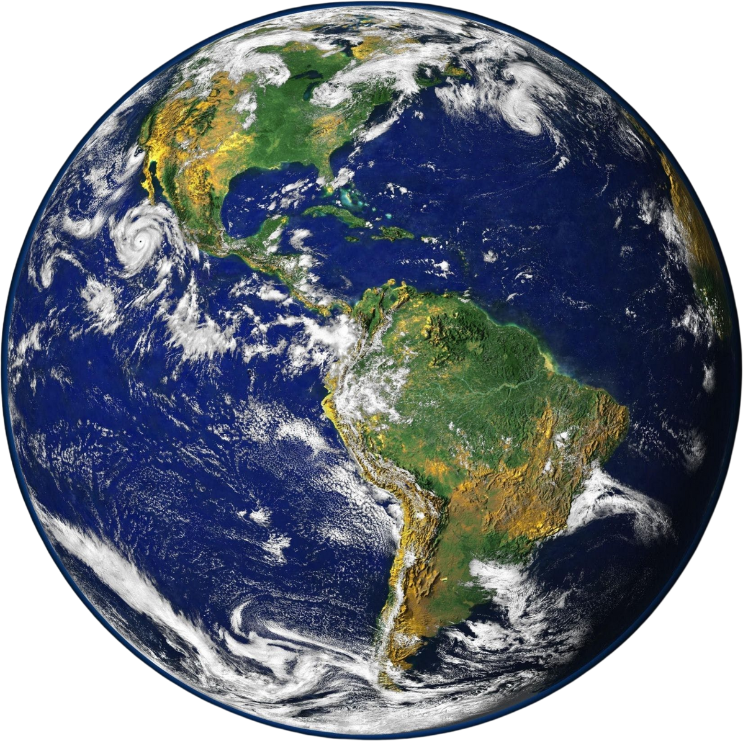
“What do you see?”
“What do you know about Earth Day?”

Slide 3

What is Earth Day?
Earth Day, celebrated on April 22nd, is a day to raise awareness about environmental issues and encourage actions to protect the Earth. It reminds us of the importance of sustainability and inspires us to make eco-friendly choices every day.

Slide 4
Vocabulary

Slide 5
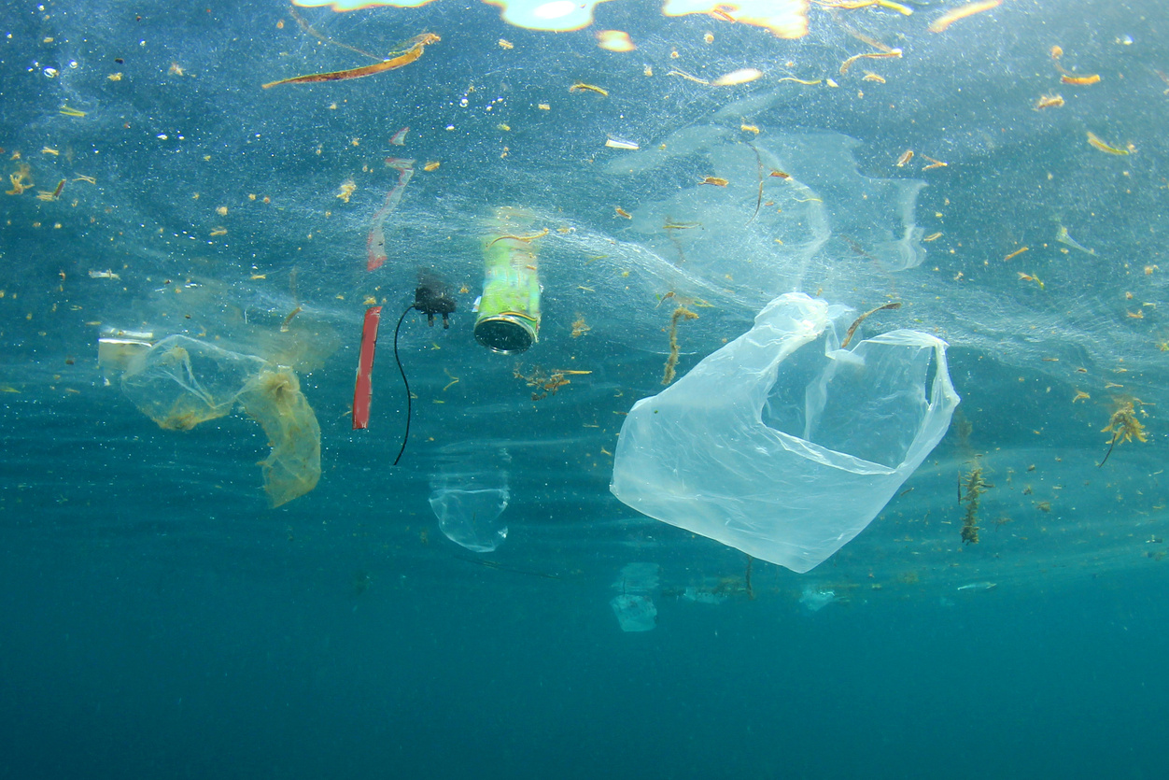
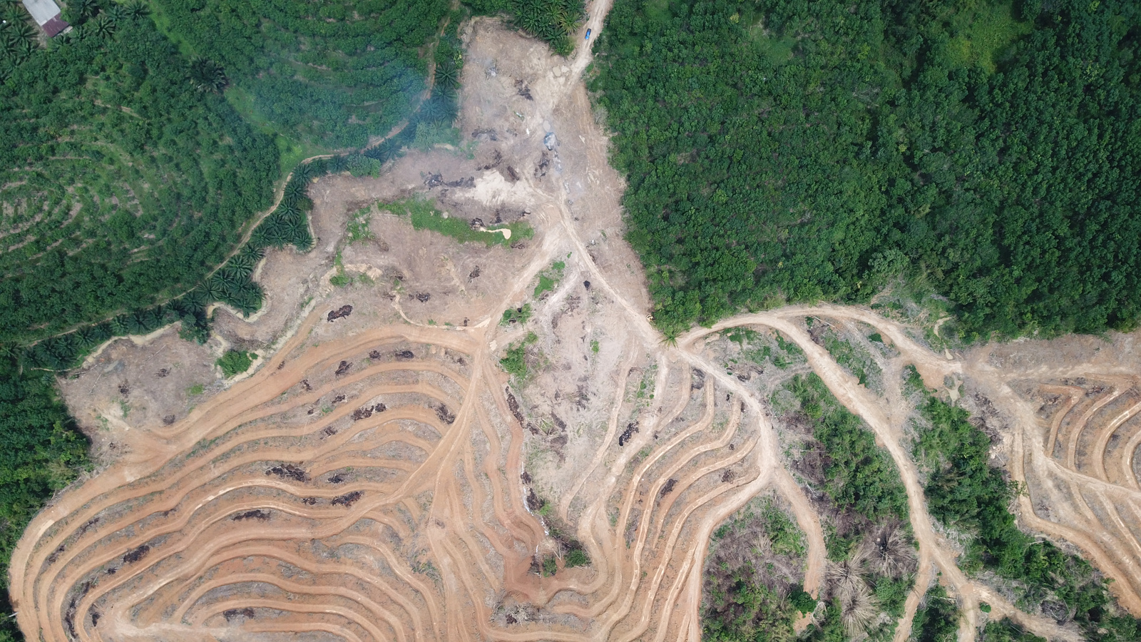
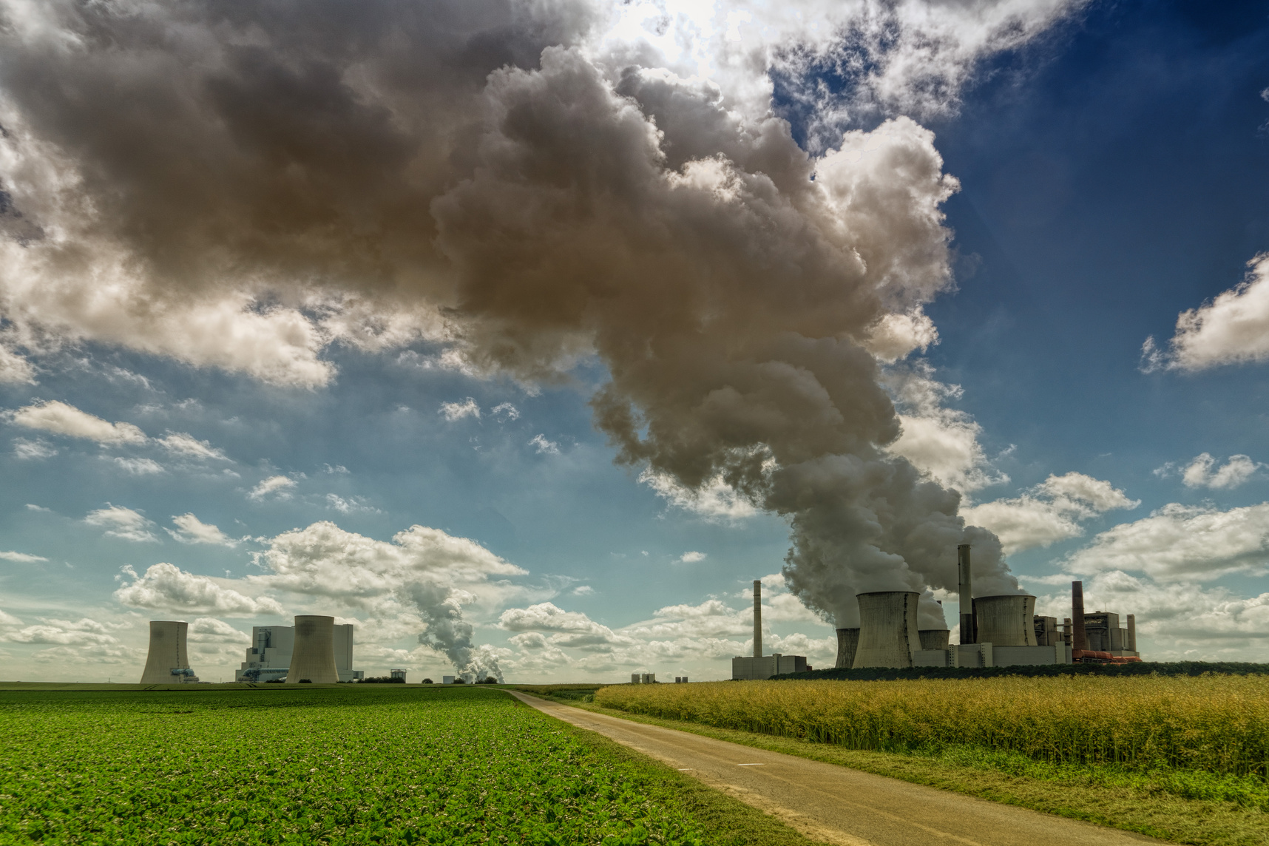
Environmental Issues
Pollution
Deforestation
Climate Change

Slide 6
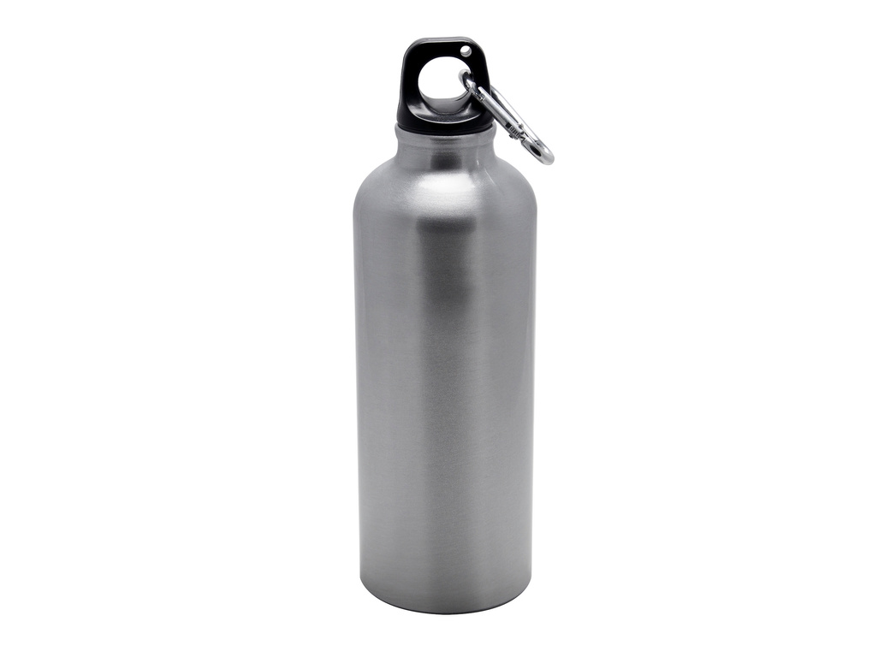
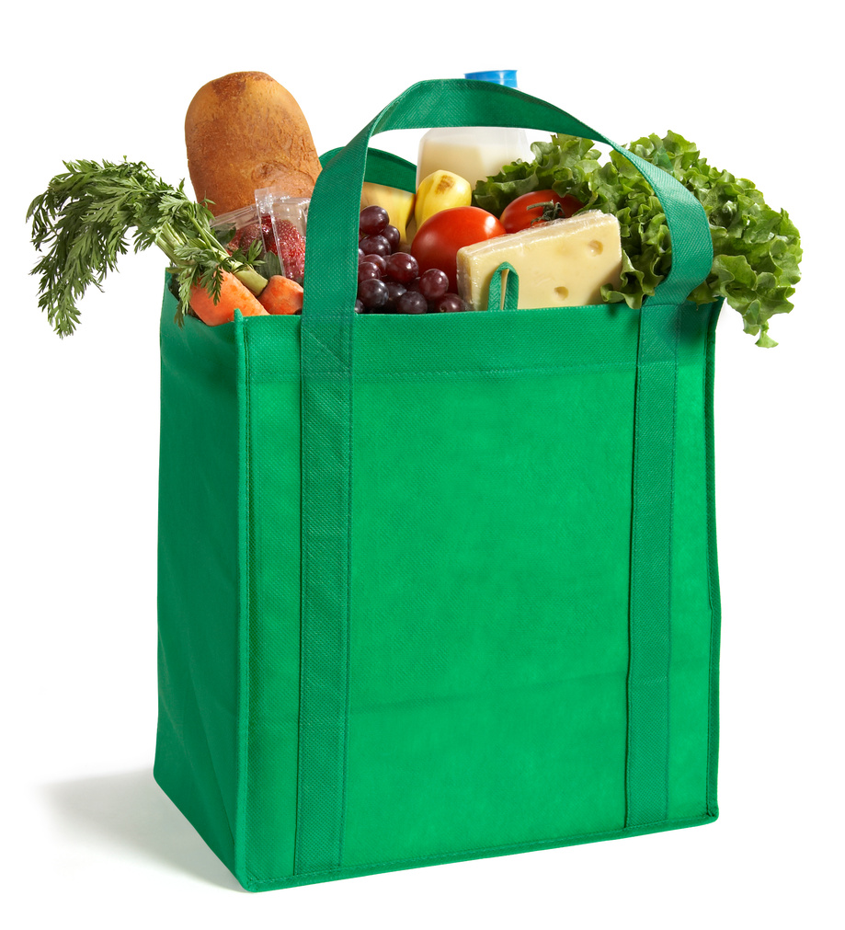
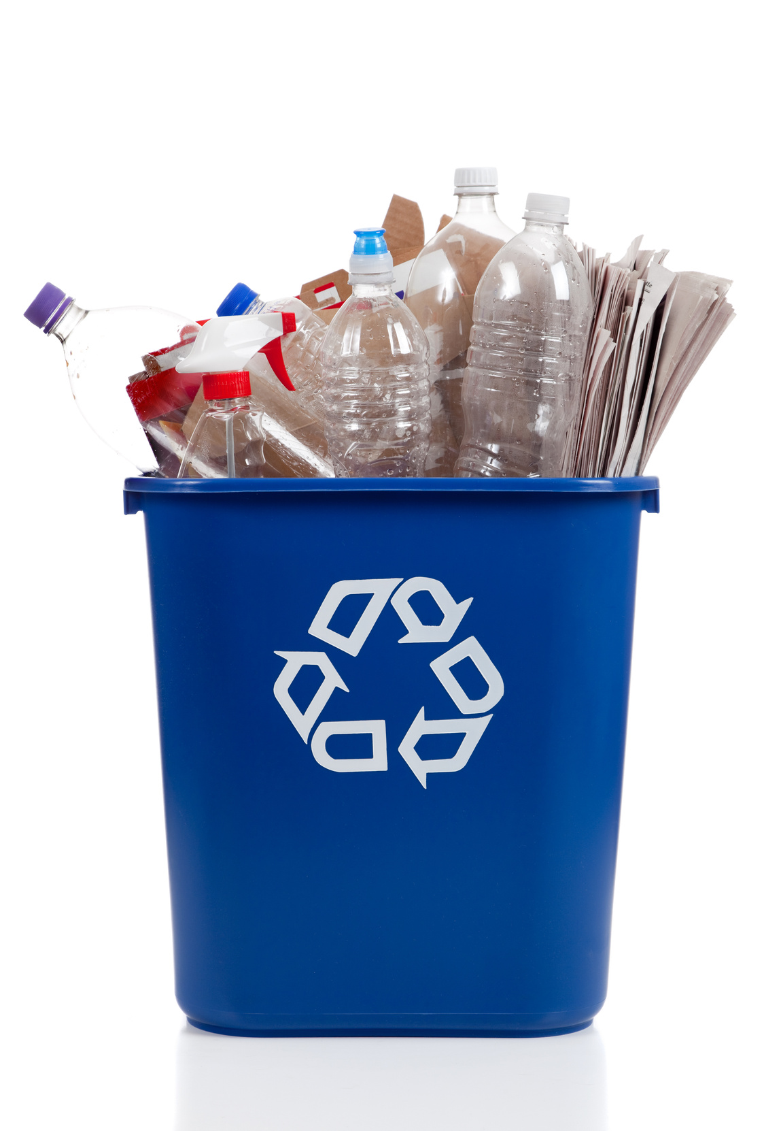
The Three R’s
Reduce
Reuse
Recycle

Slide 7
What is the difference between these 3 words?
Reduce
Reuse
Recycle

Slide 8

How to Reduce Waste:
Reduce means to use less of something.
When we reduce, we use less stuff, which helps make less waste. For example, we can reduce waste by using both sides of a piece of paper or turning off lights when we're not using them.

Slide 9

How to Reuse Waste:
Reuse means to use something again instead of throwing it away.
When we reuse, we find new ways to use things instead of getting rid of them. For example, we can reuse a plastic bottle as a pencil holder instead of throwing it away.

Slide 10
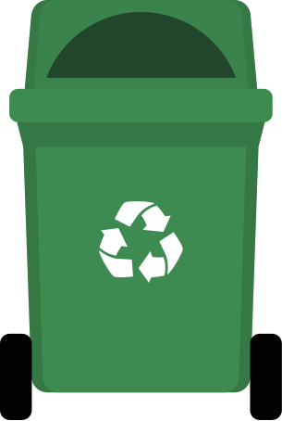
How to Recycle Waste:
Recycle means to turn something old into something new.
When we recycle, we collect things like paper, plastic, and metal and send them to a place where they can be made into new things. For example, old newspapers can be recycled into new paper products.

Slide 11
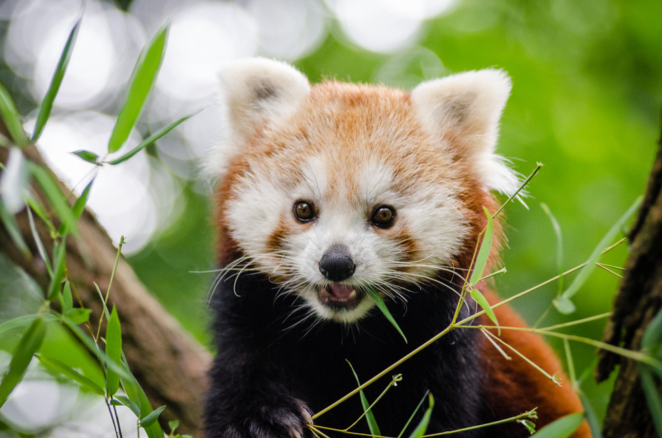
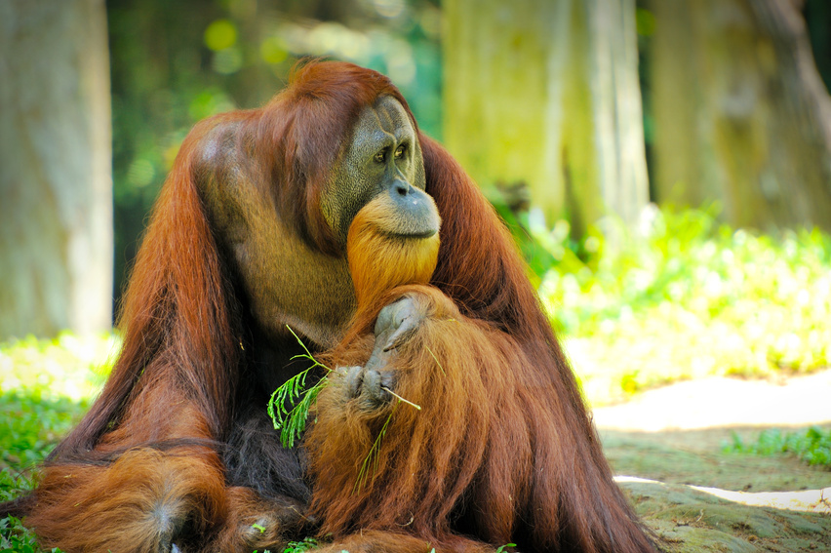
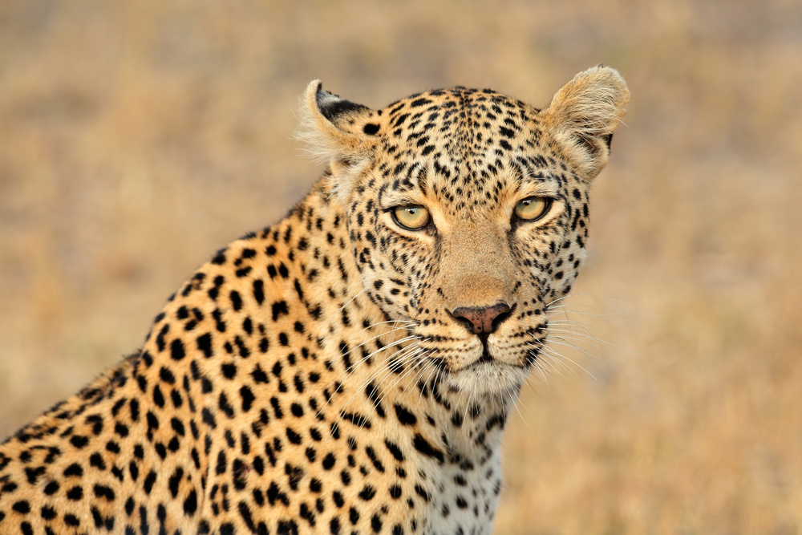
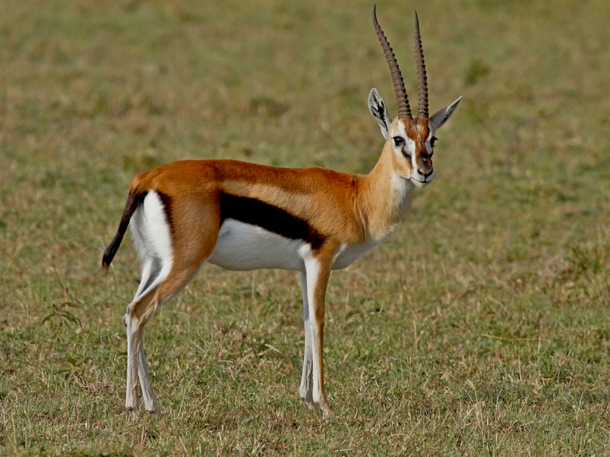
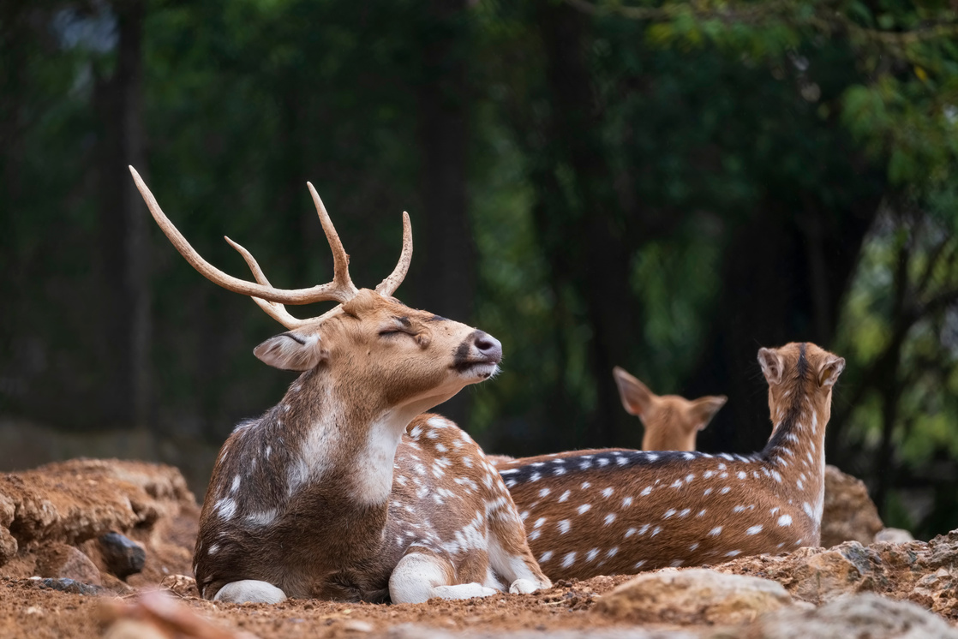
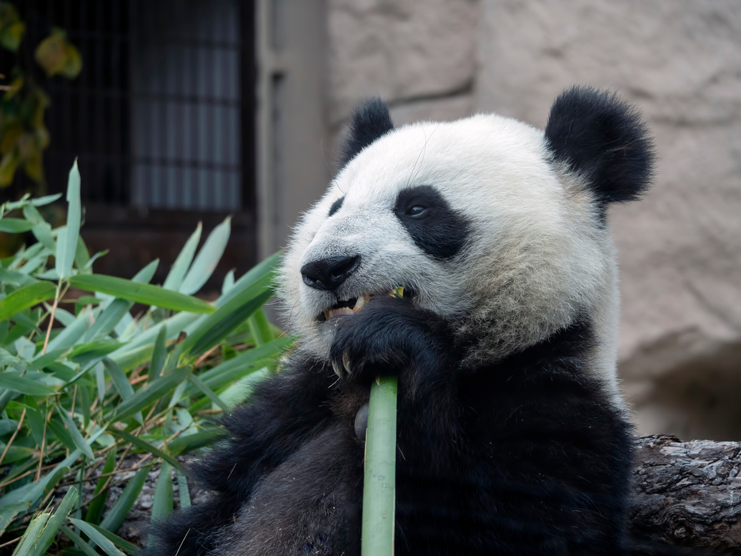
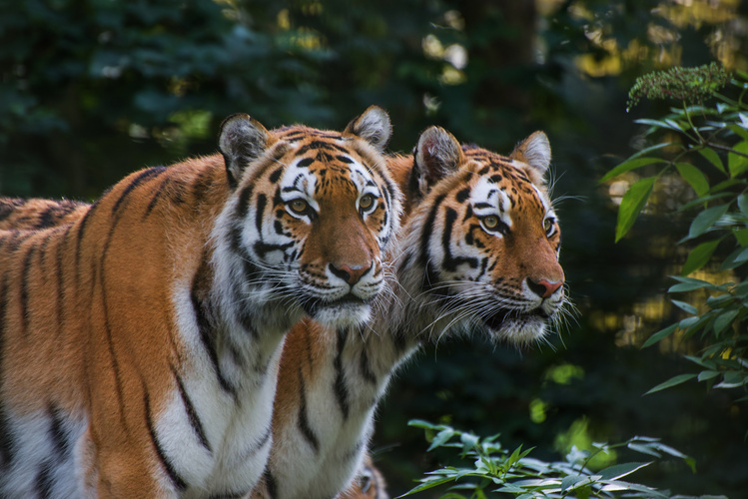
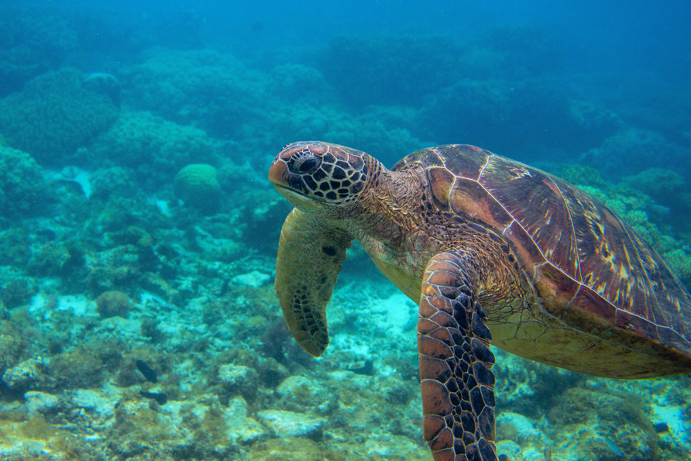
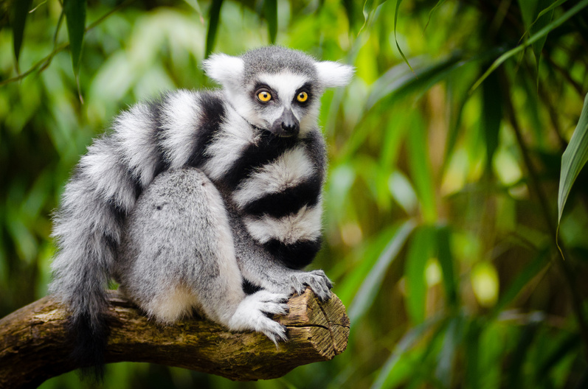
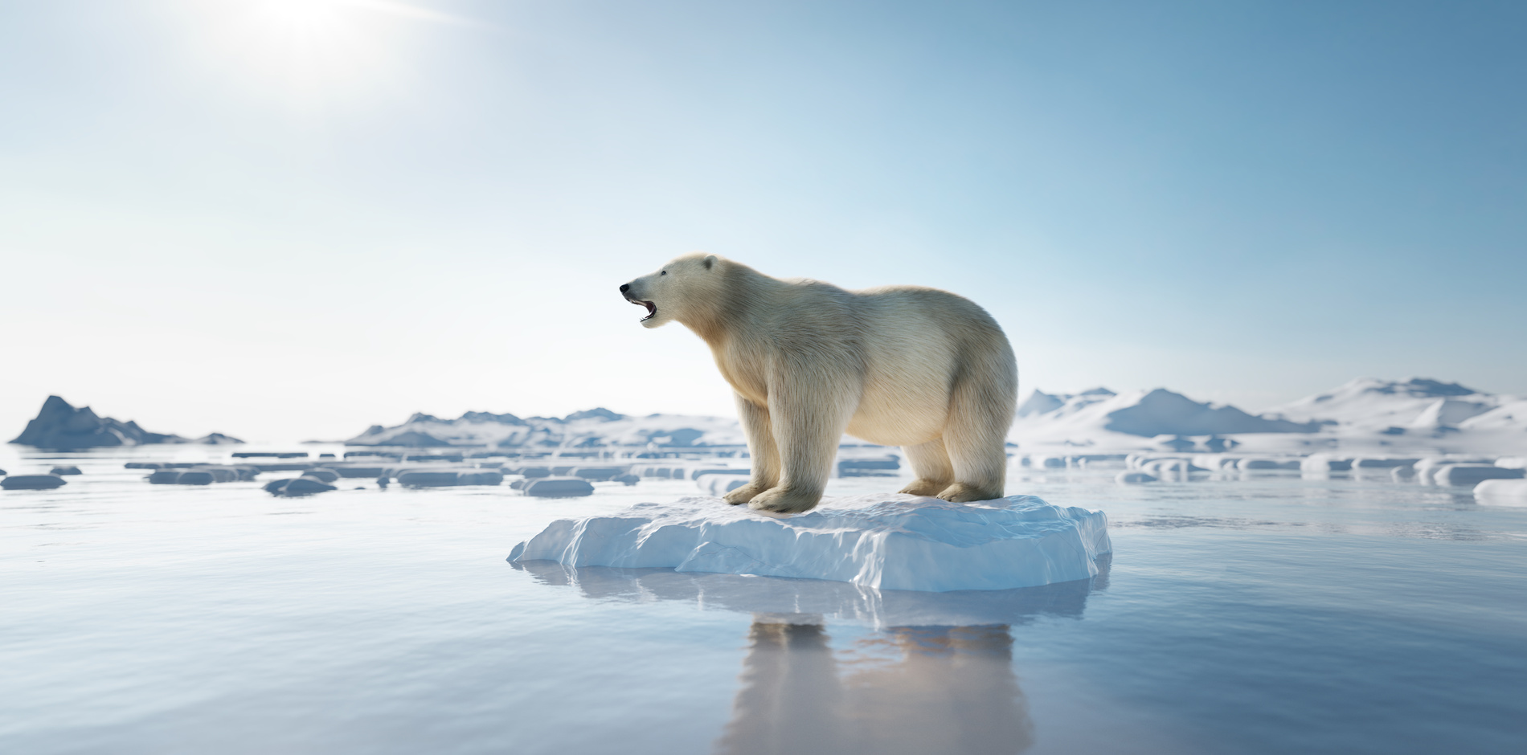
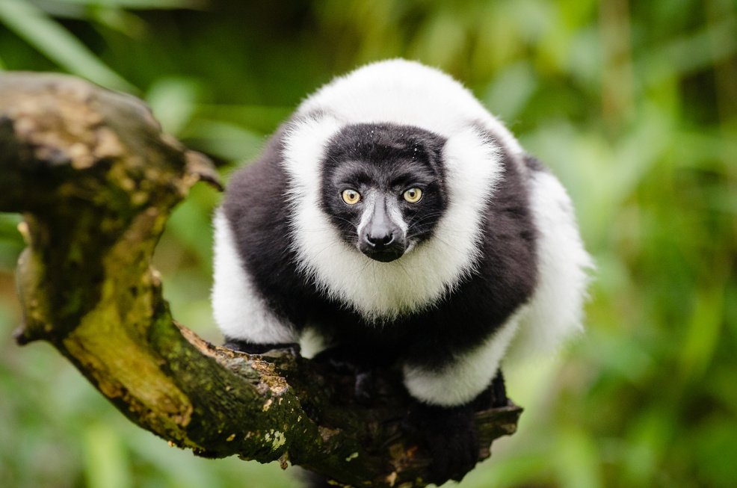
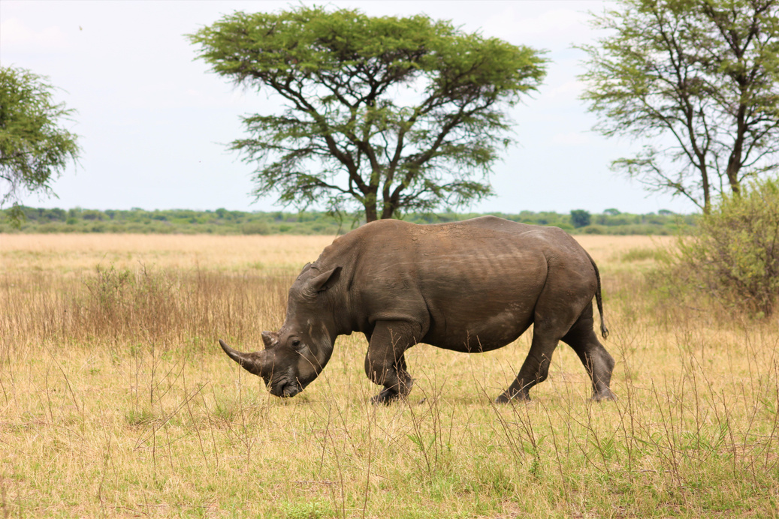
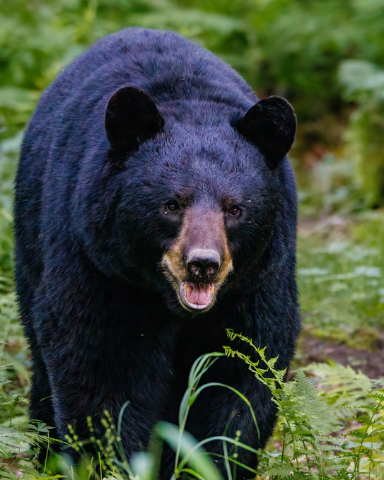
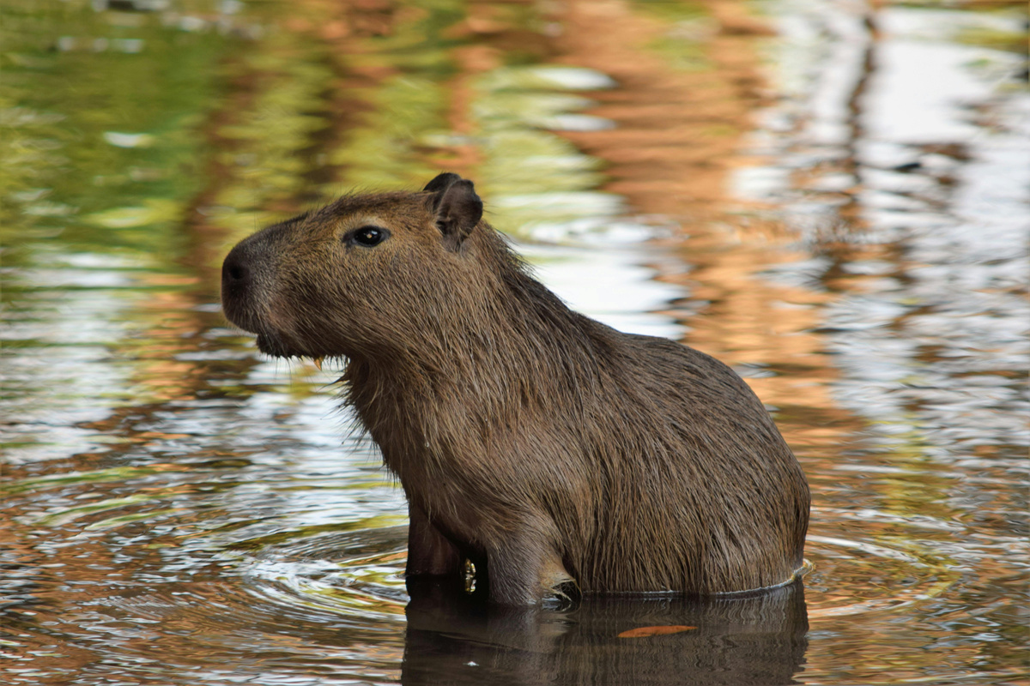
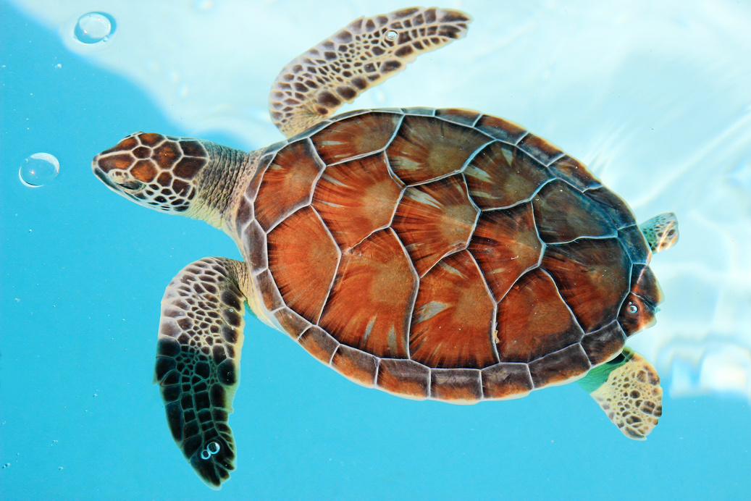
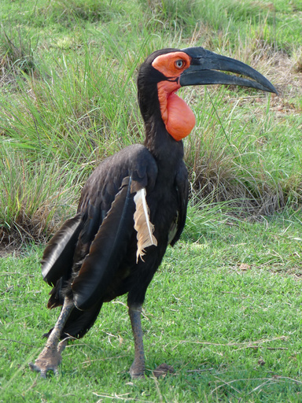
Endangered Animals

Slide 12
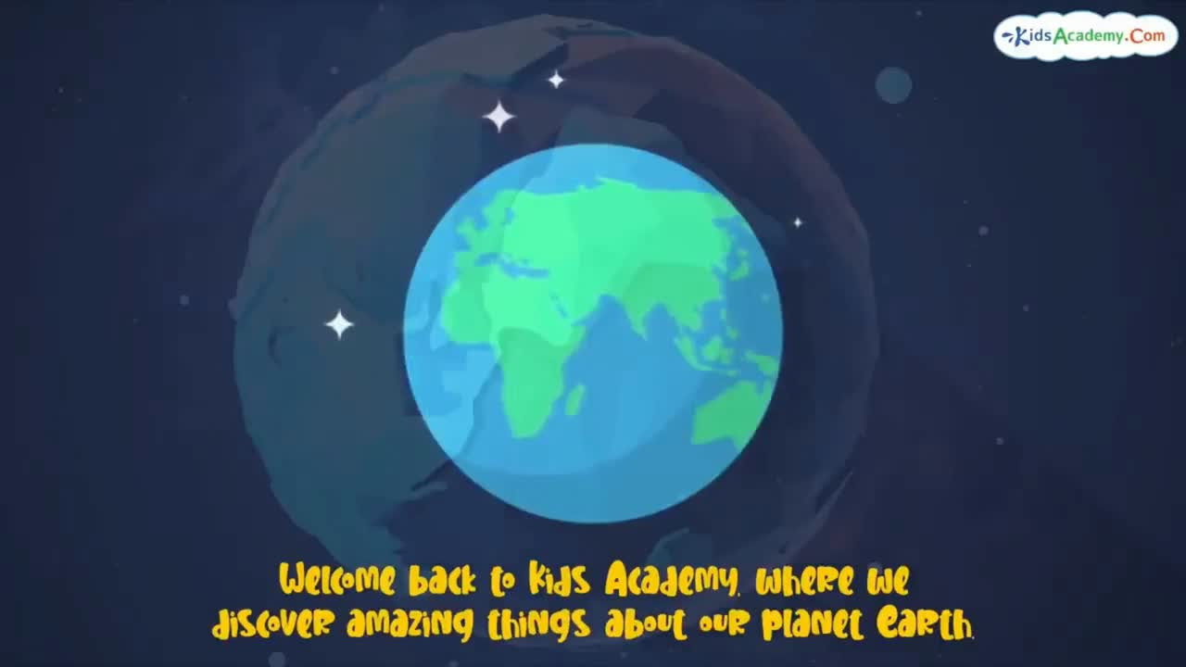
“What did you see?”
“What can we do to help the Earth?”

Slide 13
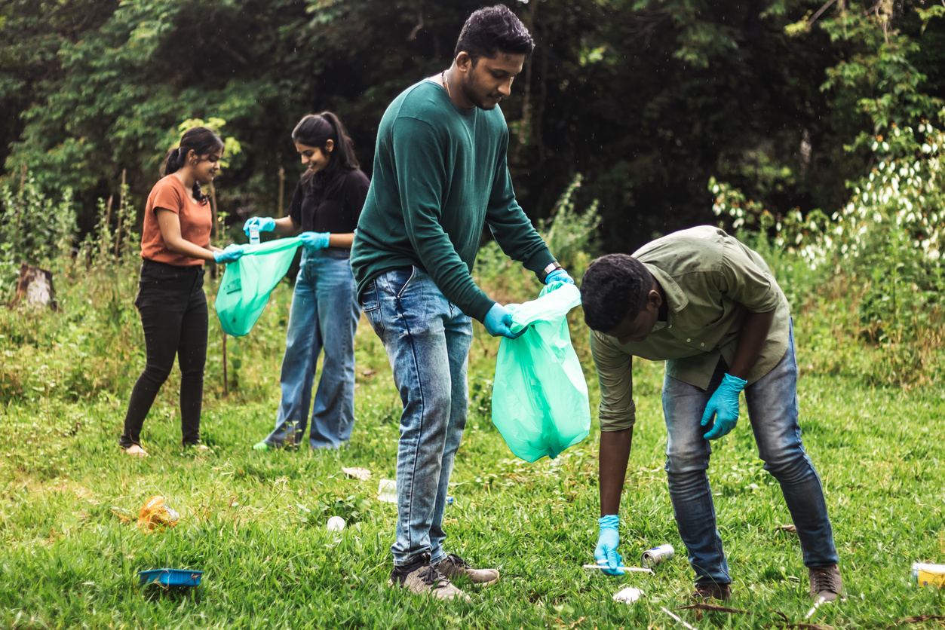

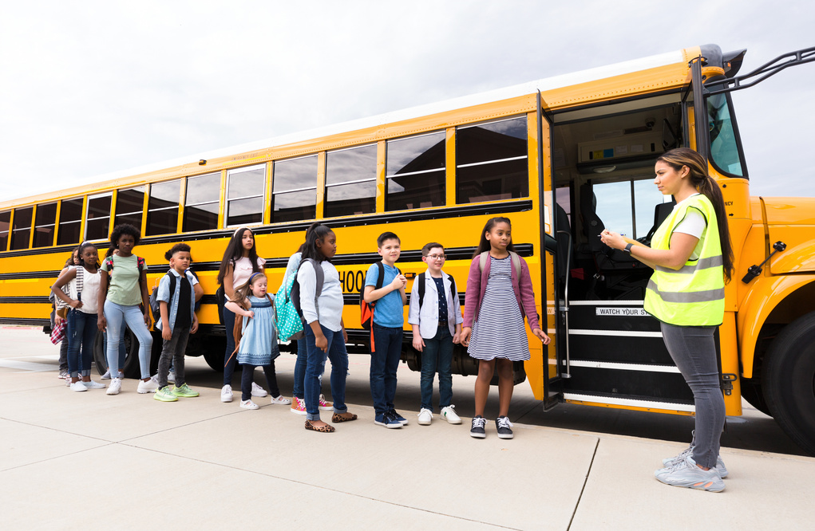
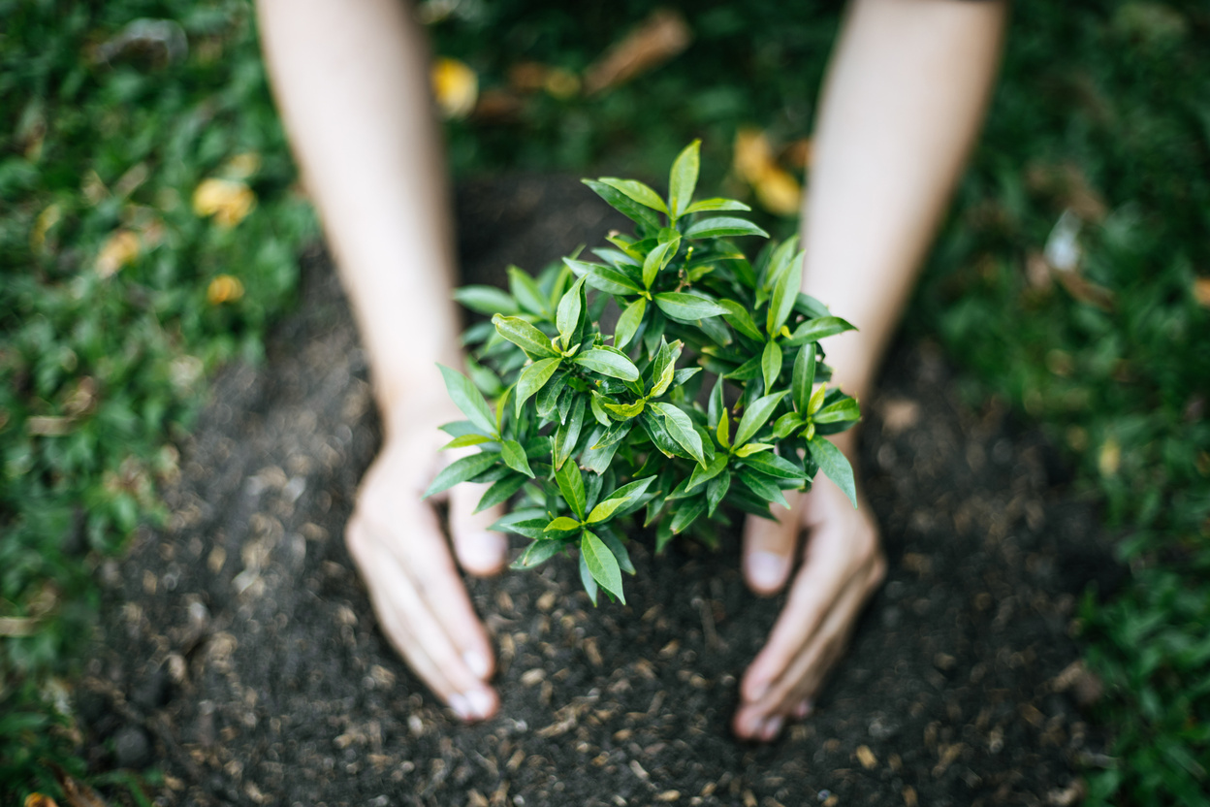
I Can Help the Earth
Show a model sentence: “I can help the Earth. I can ___.”
Each student says one or two sentences.

Slide 14
Every Day is Earth Day
Let's make every day Earth Day! Remember the three Rs: Reduce, Reuse, and Recycle. Use less, find new ways to use things again, and recycle whenever you can. Every small action helps our planet!

